Slide 1


SMART INDIA HACKATHON 2024
InFlux
Charging ahead with seamless power
Problem Statement ID- SIH1595
Problem Statement Title- InFlux
Theme- Smart Vehicle
PS Category- Software
Team ID- MITADTSW337
Team Name- C2 Innovative

Slide 2
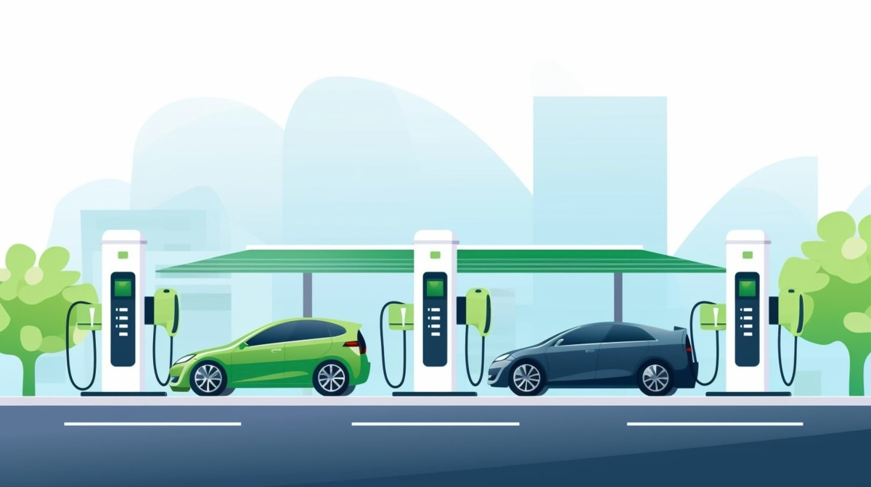
InFlux Charging ahead with seamless power
C2 Innovative
Proposed Solution
Provide a centralized website for locating EV charging stations.
Collaborate with all major EV charger brands.
Offer a unified wallet for easy payments across different chargers.

Slide 3



TECHNICAL APPROACH
C2 Innovative
A responsive website providing real-time station discovery.
Integrate APIs from charger brands for location and availability data.
Secure online payment systems for the unified wallet.

Slide 4
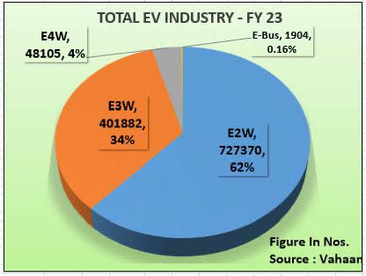
FEASIBILITY AND VIABILITY
C2 Innovative
Growing demand for web-based EV charging solutions with market growth.
Collaborating with brands reduces infrastructure challenges.
Secure payment systems ensure user trust and adoption.
Scalable for future additions like mobile app compatibility.

Slide 5
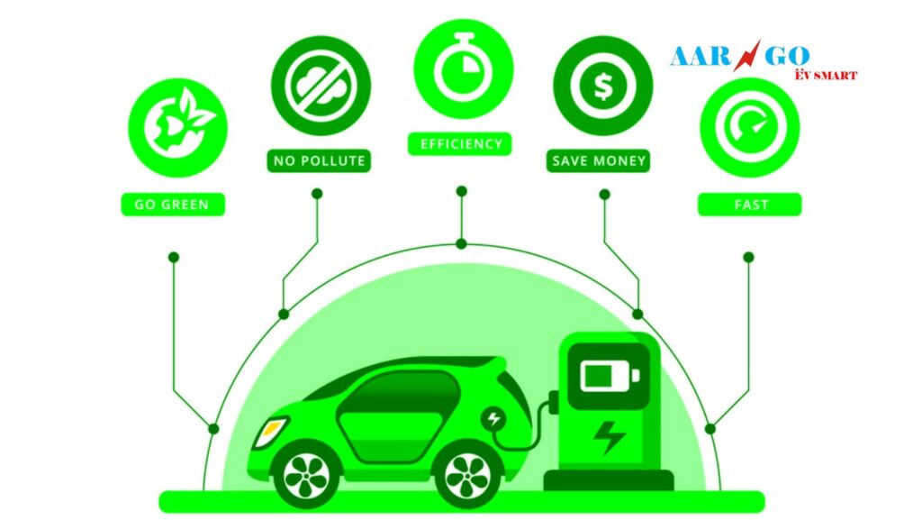
IMPACT AND BENEFITS
C2 Innovative
Simplifies the search for EV charging stations via a web platform
Unified wallet improves user convenience and transaction speed.
Strengthens the EV ecosystem by promoting green transportation.
Increases revenue for participating EV charger brands.

Slide 6
RESEARCH AND REFERENCES
C2 Innovative
Research Topic | Source
EV Growth Market | McKinsey Report 2023
Charger Network Expansion | IEA Global EV Outlook
Consumer Behavior Analysis | Deloitte Ev Survey
Unified Payment Systems | PwC Fintech Study

Slide 7
IMPORTANT INSTRUCTIONS
Please ensure below pointers are met while submitting the Idea PPT:
Kindly keep the maximum slides limit up to six (6). ( Including the title slide)
Try to avoid paragraphs and post your idea in points /diagrams / Infographics /pictures
Keep your explanation precise and easy to understand
Idea should be unique and novel.
You can only use provided template for making the PPT without changing the idea details pointers (mentioned in previous slides).
You need to save the file in PDF and upload the same on portal. No PPT, Word Doc or any other format will be supported.
Note - You can delete this slide (Important Pointers) when you upload the details of your idea on SIH portal.

Slide 8
Rubrics of Evaluation
Assessment Phase/Category | Weightage | Parameters/Points | What evaluators should look for | 20-25 | 10-20 | 0-10
RESEARCH | 10% | Extensiveness of research/ Problem Validation/Desirability | Level of research conducted to understand the problem statement and it's need in the market | Excellent understanding of problem, Primary and secondary extensive research done, analysis done | Satisfactory understanding of problem, Only primary or only secondary research done well but no analysis | Unsatisfactory understanding of problem, Poor quality research done
IDEATION | 40% | Novelty | How innovative or novel is the idea suggested by the team? | Very Innovative idea and is still being/ to be explored in the industry/market | Have seen/heard before but still unexplored and needs more such ideas to make it scalable | Very common and has many solutions for it
 |  | Technical Solution | Level of detailing done to present the idea - could be a sketch, 3D printing design, workflow diagram or something else | Extremely intelligent design with details and is ready to be prototyped | Decent design with details but needs a lot of work to be able to take it to prototyping | Poorly presented, difficult to undertstand
 |  | Team Dynamics | Commitment of the team towards one another and their project | Multidisciplinary Team with complementary skill sets | Single discipline with complementary skill sets | Not much role clarity among members
FEASIBILITY and VIABILITY | 30% | Feasibility | Does the Team possess all required resources to create solution? | Have Identified all resources to create solution | Have partially identified the resources | Not much work done to identify resources
 |  | Viability | Is it financially viable solution? Will it make money? | Unit economics is well thought through and Business Plan is in place | Either Unit Economics or Business Plan in place | Both Unit economics and Business Plan are not present.
SCALABILITY | 20% | Growth Potential/Impact | Virality of Solution/ Benefits (Social, Economic, Environmental) | Very clear growth plan Engagement with community/ Community awareness - Very High | Need help to build growth plan Engagement with community/ Community awareness - Fair Enough | Not yet started on growth plan Engagement with community/ Community awareness - Low
 |  | Affordability | Pricing of the solution | Highly afforable compared to existing solution | Moderatly affordable | Highly priced with low affordability
Video Presentation |  | Not more than 3-5 minutes | Content of the video presentation (Capturing the entire innovation solution journey in the entire video) | Very well presented; Capturing : Prototype demonstration + On-ground testing/Prototyping + User validation + Defining Problem statement | Decently presented; Capturing : Prototyping + User validation + Defining Problem statement | Presented; Capturing problem statement only

